Slide 1

Data Analysis in Snap
MKTG2341 PC Lab 7

Slide 2

Data Analysis Using Snap
Download Data from Snap Online to Snap 9 Pro.
Preview Data in Snap 9 Pro
Analyze data in Snap 9 Pro.

Slide 3
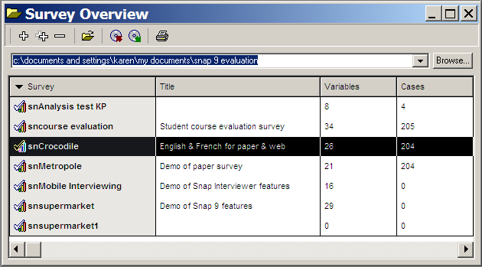
Sample Survey
We will use a sample survey for today’s lab

Slide 4
Analyzing Data
Two ways to view and analyze survey
data in Snap:
In real time on Snap Online.
You cannot save the analyses.
To preview the results.
Useful for client access to preliminary results.
In Snap 9 Professional, after you have downloaded data from Snap Online, or imported it from an Excel database.

Slide 5

Downloading Data from Snap Online to Snap 9
Notes:
Most of this is covered in Guide 5. Online Interviewing & Analysis

Slide 6
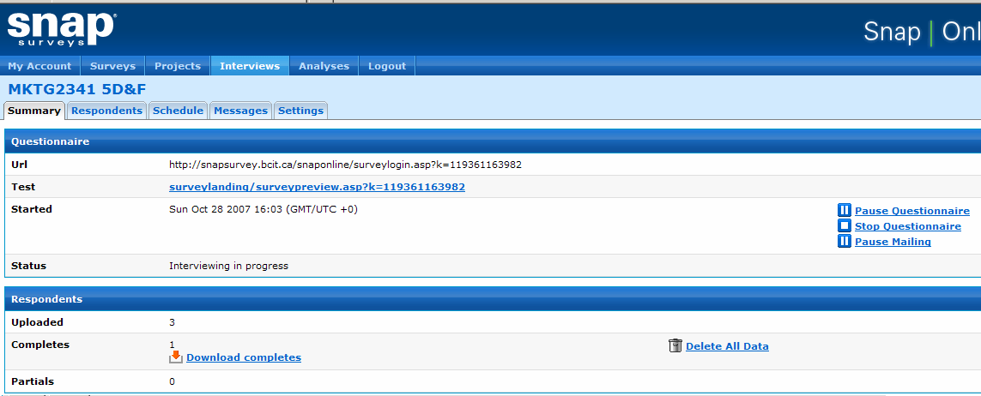
Downloading Data
First step is to Stop Questionnaire:

Slide 7
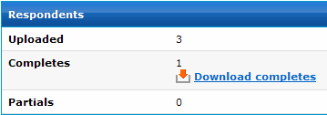
Downloading Data
To see completed responses click: Interview | Summary
In the Respondents section, Completes: see icon

Slide 8
Downloading Data

Slide 9
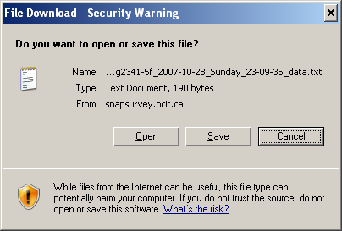
Downloading Data
Select the Interviews | Summary tabs
Click on Completes icon.
Click on Save
The data will be stored in a .txt format in your destination folder.
File Name:
… _data.text

Slide 10
Load Data in
Snap 9 Pro
Notes:
Most of this is covered in Guide 5. Online Interviewing & Analysis

Slide 11
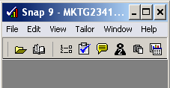
Load Data into Snap 9
Next step is to load data into Snap 9 Professional for displaying the responses.
Open the Survey (questionnaire) in Snap 9 Professional.
Click on Data Entry icon.
Click File | Import.
11
11

Slide 12
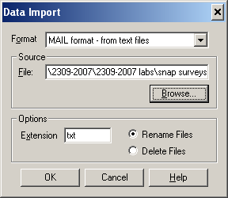
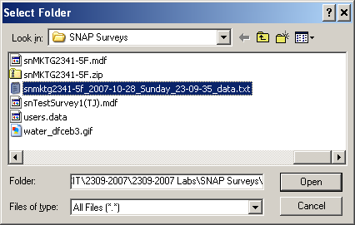
Load Data into Snap 9
Set Format to MAIL format – from text files
File extension .txt
Point browser to file
Change Files of Type to: All Files *.*
Filename ends with “…_data.txt”)
Notes:
page 5-140

Slide 13
Previewing Data in Snap 9 Pro
Notes:
Most of this is covered in Guide 5. Online Interviewing & Analysis

Slide 14

Preview Data
You can view the data in several modes.
Data Questionnaire Mode
Data Entry Mode

Slide 15
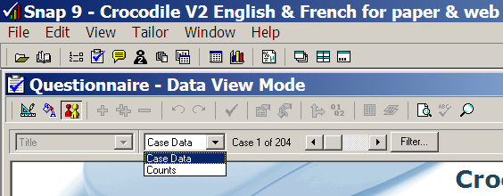
Preview Data: Questionnaire Mode
Data Questionnaire Mode
Click Data View Mode:
Two options
Case Data - Data from each respondent.
Counts - Data from all respondents.

Slide 16
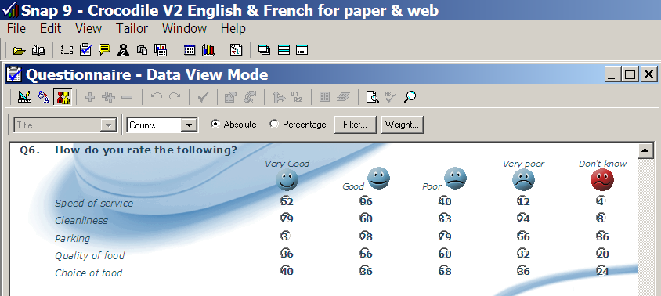
Example Preview: Questionnaire Mode - Counts
Click Questionnaire
Click Data View Mode
Click Counts to see summary of all cases
Choose between Absolute (Frequency) or Percent

Slide 17
Preview Data: Data Entry Mode
Data Entry Mode
Two options:
Click Prompted Mode
You now see a list of the variables and the answer for one case (=respondent) at a time
Click Questionnaire Mode
You now see the questionnaire with answers from each respondents displayed in the response boxes.

Slide 18
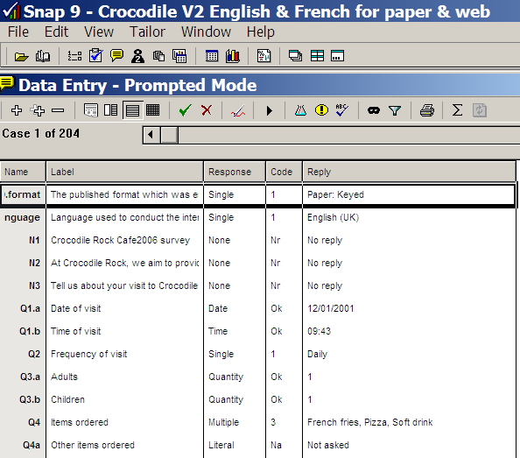
Example Preview: Data Entry – Prompted Mode
Data Entry
Prompted Mode
Case 1 of 204
Case=Respondent
You now see a list of the variables and the answer for each case (respondents)

Slide 19
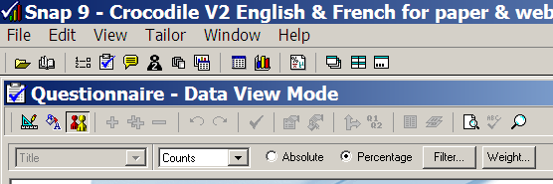
Pre-View using Filter
Filter allows you to pre-view data for certain cases only.

Slide 20
Preview using Filter
The Filter button allows you to display the data for a select group of respondents.
For example, specifying Q2=(3,4) will display only the data for respondents who use the restaurant weekly or monthly.

Slide 21
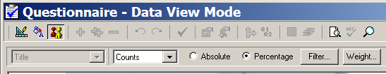
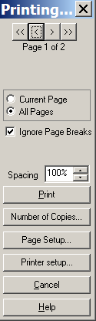
Printing Preview Data
Click to Print the Preview of your data in the questionnaire.
Ignore page breaks

Slide 22
Producing Data Tables in Snap 9 Pro
Notes:
Most of this is covered in Guide 5. Online Interviewing & Analysis

Slide 23

Producing Tables in Snap 9
Choose Variables to display the list of variables (=questions).
Choose to display the Results Definition dialog box.
Specify which question you want to analyze.
Hitting at this point will display only counts (i.e., number of respondents who gave each type of answer).
Choosing Base Percents will express all answers as a percentage of the total number of respondents.

Slide 24

Producing Tables in Snap 9
Choose Variables to display the list of variables (=questions).

Slide 25
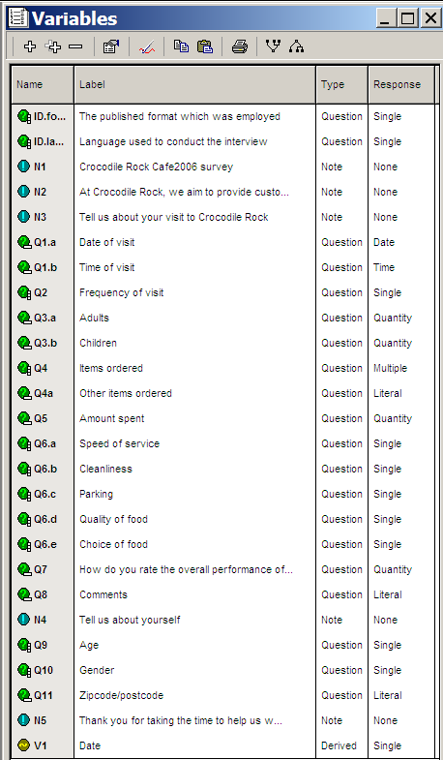
Producing Tables in Snap 9
When clicking Variables the list of variables (=questions) is displayed.

Slide 26
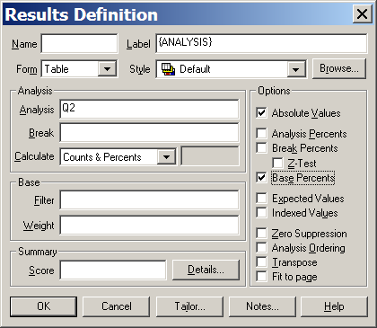
Producing Tables in Snap 9
Choose to display the Results Definition dialog box.
Specify which question you want to analyze.
Specify the Options for % displayed.
You can Drag & Drop the variables into the window

Slide 27
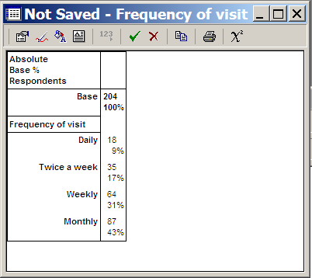
Producing Tables in Snap 9
Hit to display your table.

Slide 28

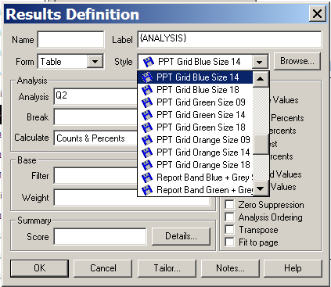
Choose Style of the Tables
To change the layout of the table, click Properties
In the Results Definition window choose a Style.

Slide 29
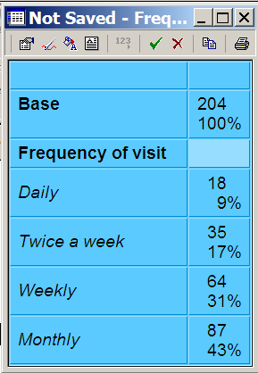
Choose Style of the Tables

Slide 30
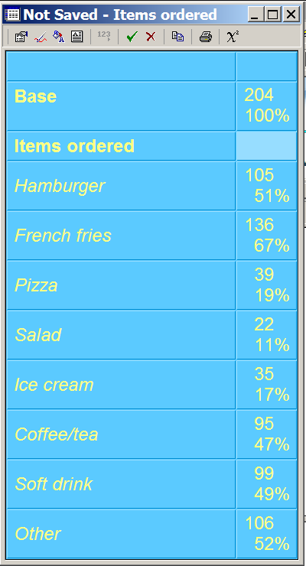
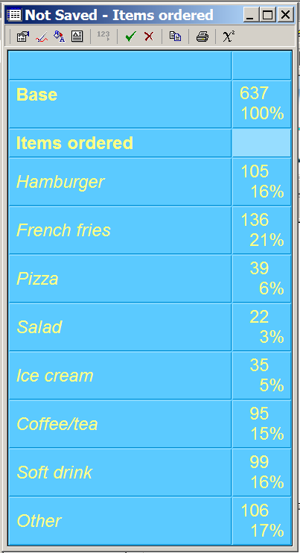

Producing Tables in Snap 9
Multiple Response Qs
You can choose to display the frequency base as:
Respondents
Responses
To switch base click

Slide 31
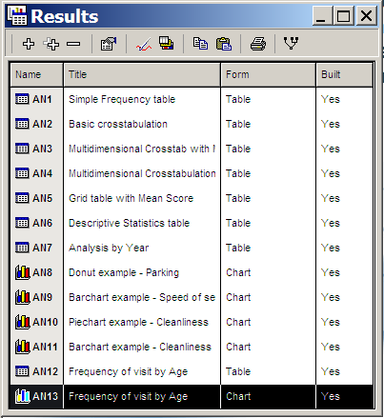
Producing Tables in Snap 9
Click to save your table.
If you want to work on it again, it will be saved in the Results Window

Slide 32
Producing Charts in Snap 9 Pro
Notes:
Most of this is covered in Guide 5. Online Interviewing & Analysis

Slide 33
Producing Charts in Snap 9
The process of producing Charts in Snap 9
is very similar to that for producing tables.
Choose Results Chart to display the Results Definition dialog box.
Choose Variables button to display your questionnaire variables.

Slide 34
Producing Charts in Snap 9
Drag & Drop Variables into the relevant boxes in the Results Definition menu.
Click Chart in the Form window.

Slide 35
Producing Charts in Snap 9
Chart types can be selected from the Style menu.
You can create your own style in the Chart Designer mode

Slide 36
Producing Charts in Snap 9
Codes of a variables are referred to as Categories.
If you have both a variable and a break, the break variable is referred to as the Series.
Value of each variable is referred to as a Data Point.

Slide 37
Producing Charts in Snap 9
Hit to display your chart.

Slide 38
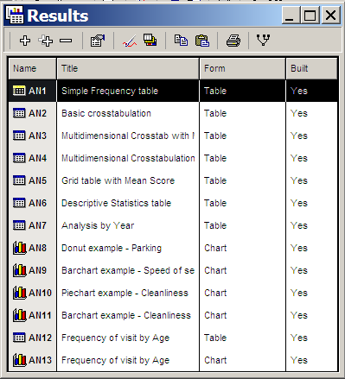
Stored Examples of Analyses

